Slide 1
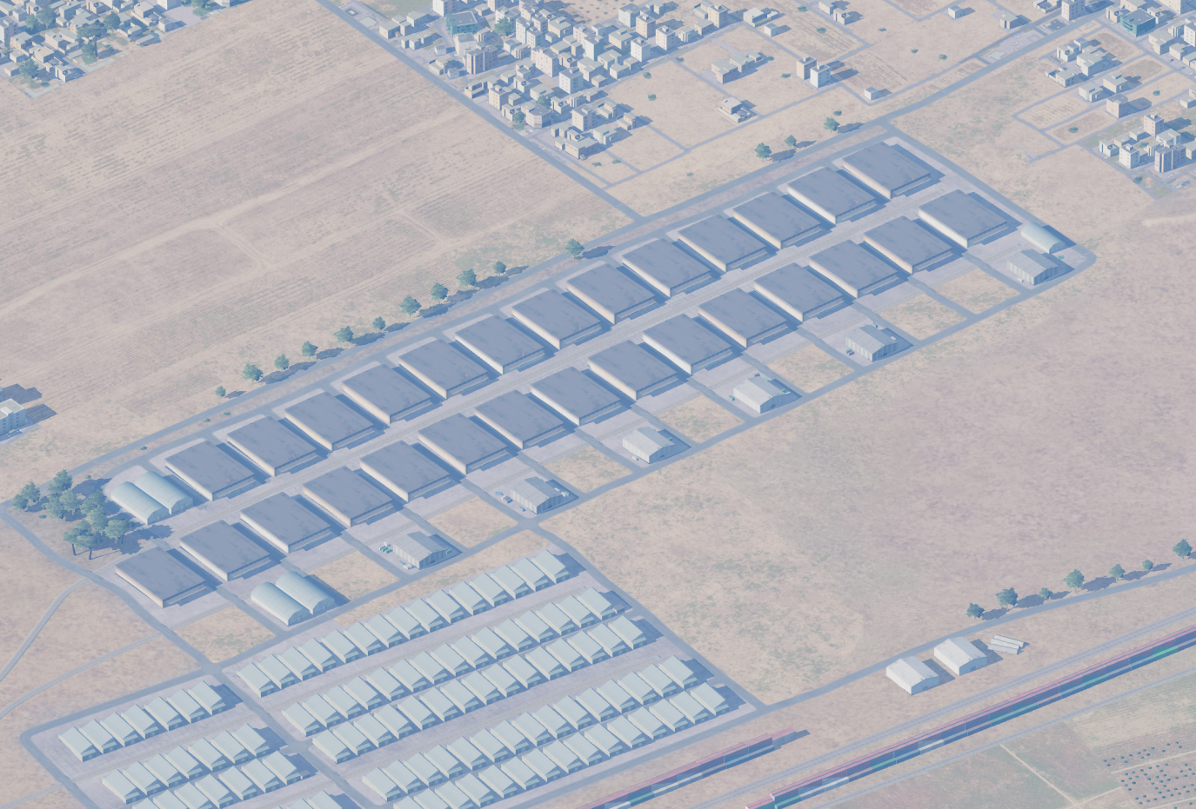
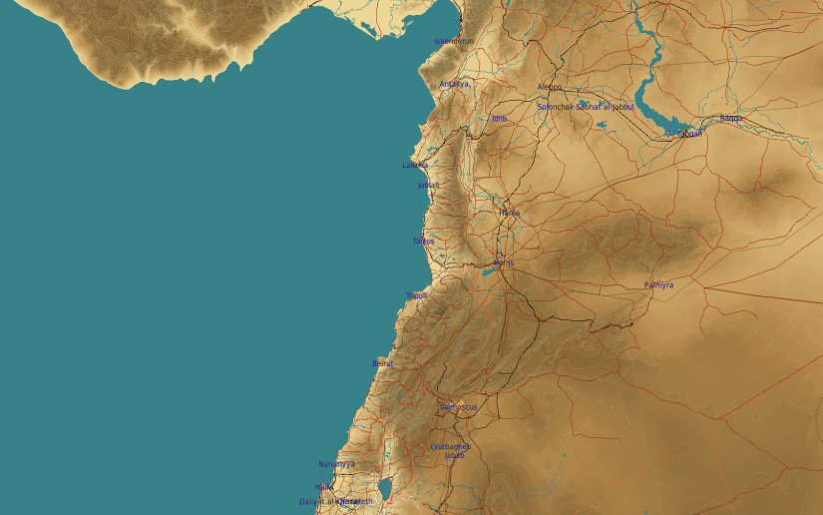
SYTGT020 SCUD Storage Site
N
20
1
2
3
DESIRED POINTS OF IMPACT WITH WPN TYPE:
DPI 1 – N 36 10.513 E 037 16.265/1204ft
DPI 2 – N 36 10.513 E 037 16.233/1204ft
DPI 3 – N 36 10.517 E 037 15.991/1207ft
DPI 4 – N 36 10.517 E 037 15.956/1204ft
Warehouses structure is based on reinforced concrete base and collumns, walls filled with brick, roof on metal frame covered with steel roof tile. 1000Ibs (GBU-32/GBU-16)
4
5
6
residential areas within 450m N and E of all DPIs (yellow)
7
8

Slide 2
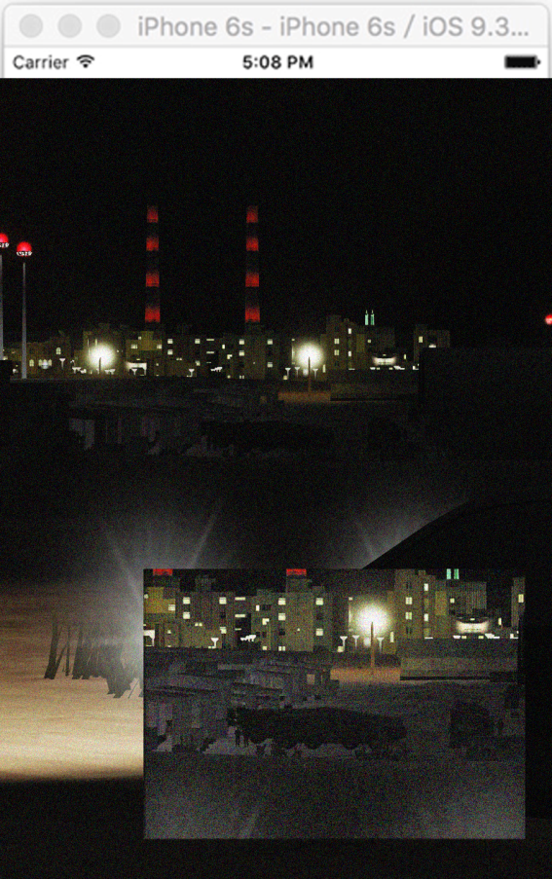
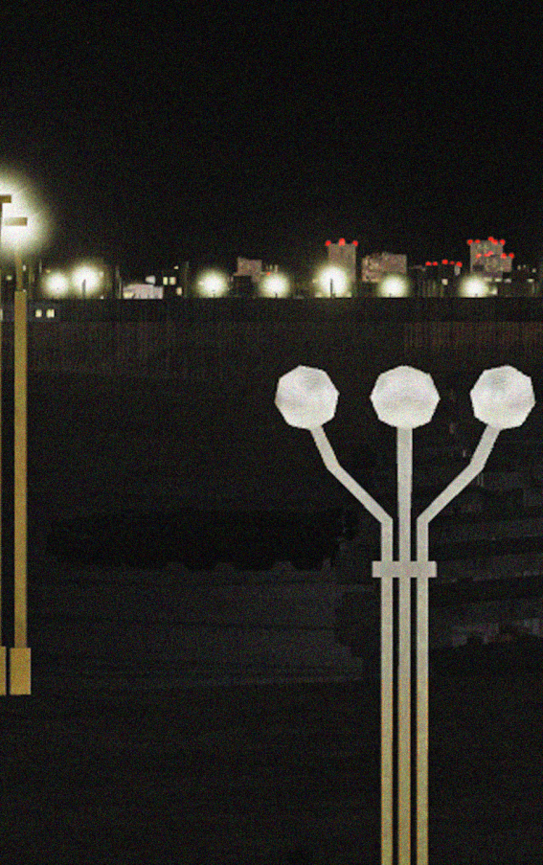
SYTGT020 SCUD Storage Site HUMINT imagery
N
2:12AM
DPI 3/4
2x SCUD
1
1
2
3
4
5
6
7
8

